Slide 1
How to Set Up a Computer Vision Environment on Windows and Linux

Slide 2
Agenda
03 | Requirements
04 | Environment Setup in Windows
07 | Environment Setup in Linux
10 | Summary

Slide 3
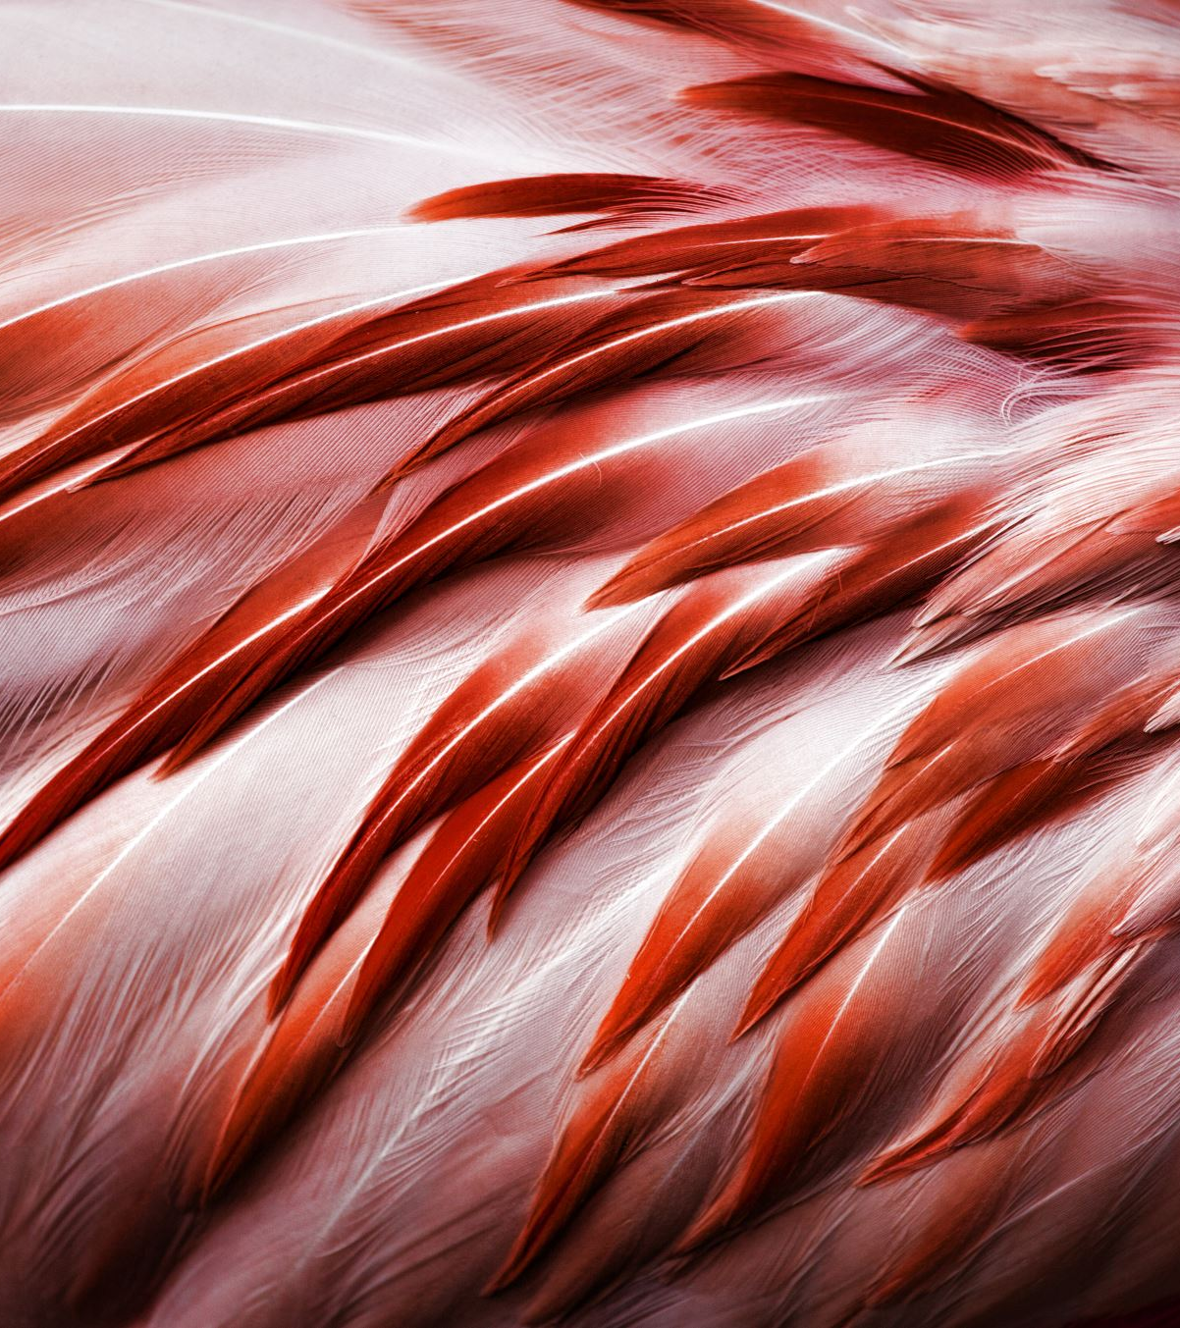
Requirements
Anaconda (2025):
Windows 10+, macOS 10.15+/11+, Linux (Ubuntu/ CentOS 7 +)
64-bit CPU(x86_64, ARM, s390x)
Minimum 5 GB free disk space.
OpenCV:
Python 3.7 to 3.12
Auto-installs: numpy, libjpeg, ffmpeg
Minimum 500MB for core features.
GPU(Optional but Recommended):
Minimum: GTX 1650 (4 GB)
Recommended: RTX 3060 (12 GB) or better

Slide 4
1. OPEN CV Environment Setup in Windows

Slide 5
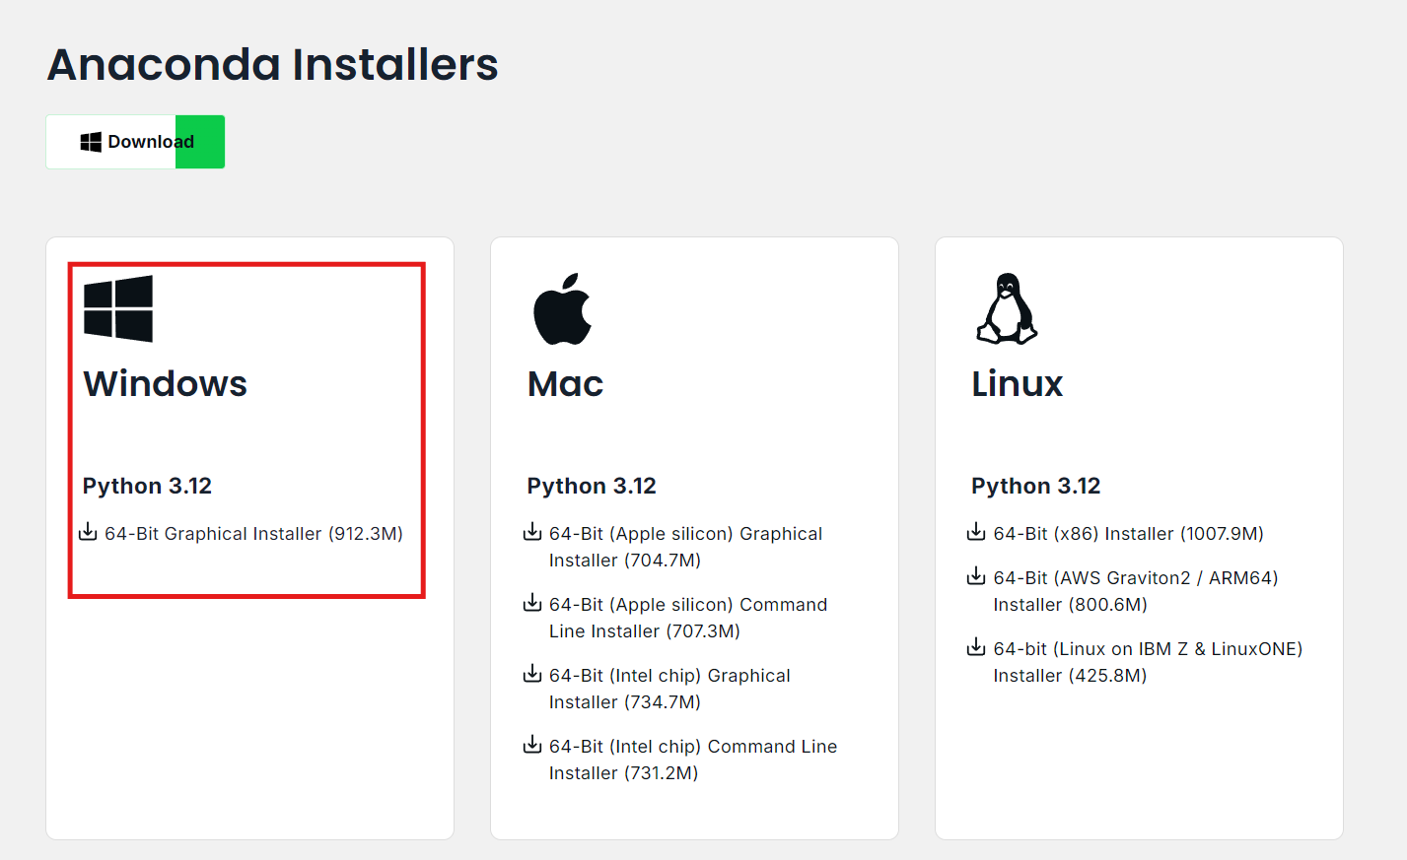
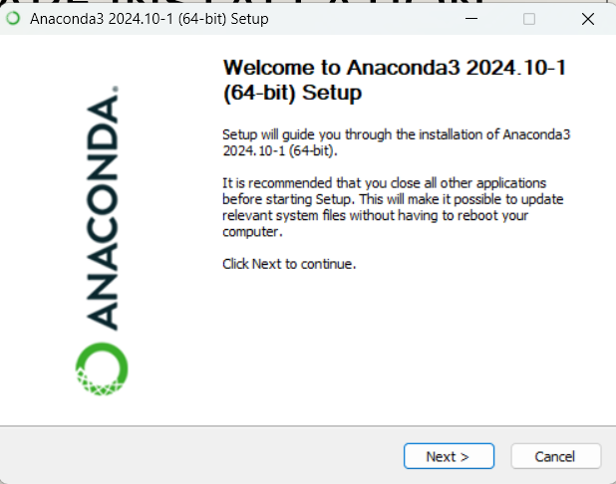
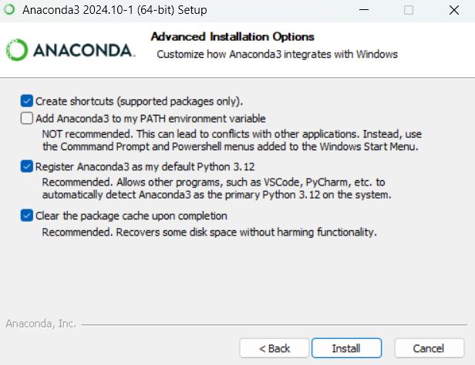
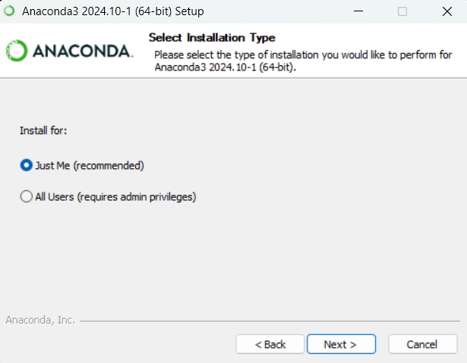
Software installation
1
2
Install Anaconda Navigator(latest version).
Run the downloaded exe file to install Anaconda Navigator.
Follow the screenshots given below to get successful installation.
4
3

Slide 6
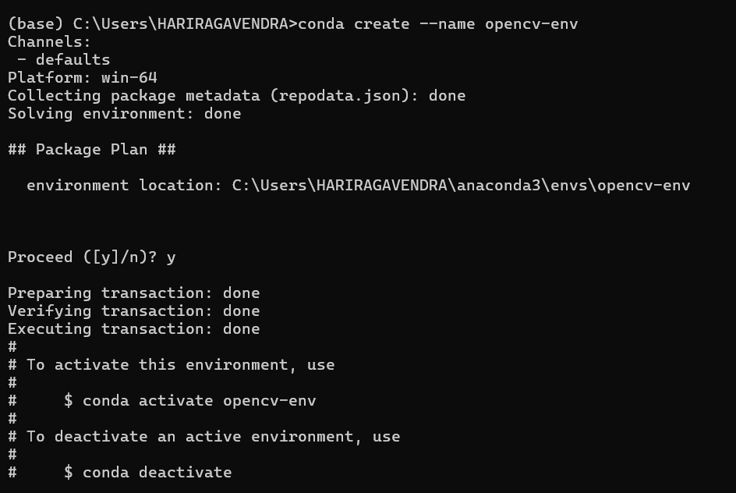
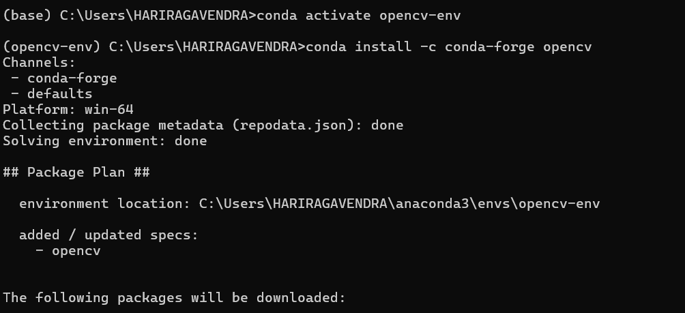
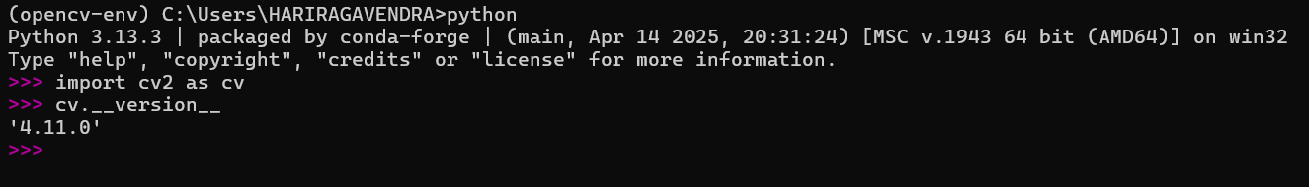
Setting up VIRTUAL environment
Open Anaconda prompt.
Enter the following command.
conda create --name opencv-env
conda activate opencv-env
Install opencv libraries.
conda install -c conda-forge opencv
Check OpenCV installation.
1
3
2

Slide 7
2. OPEN CV Environment Setup in LINUX

Slide 8
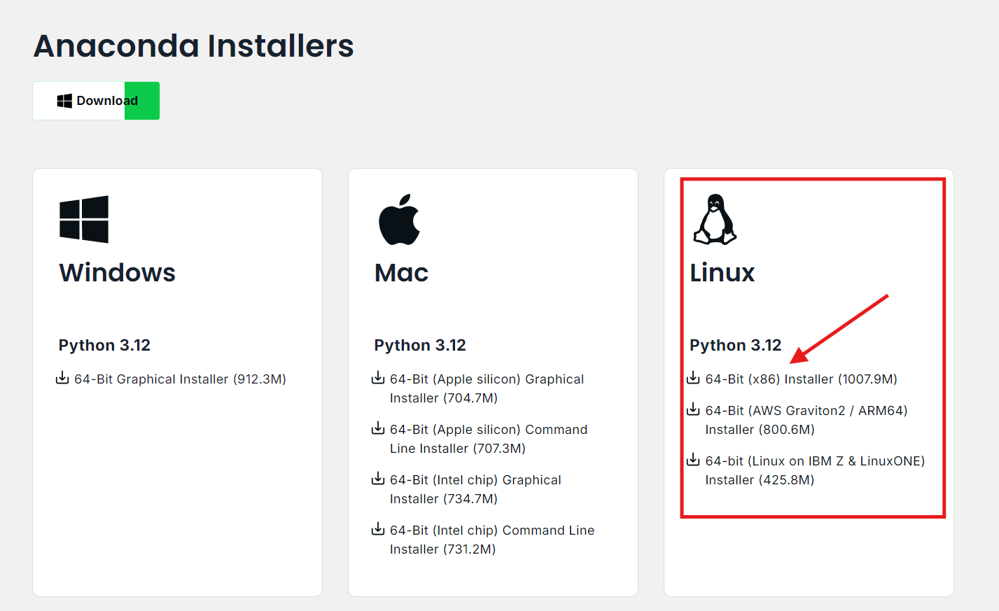
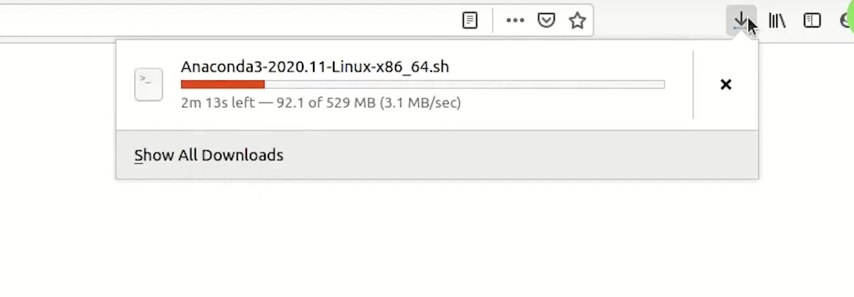
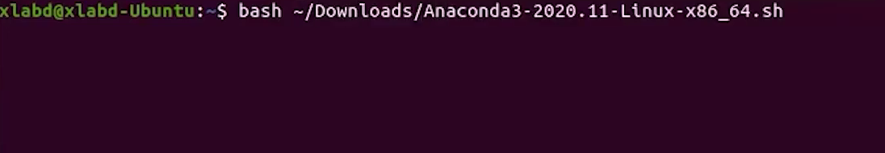
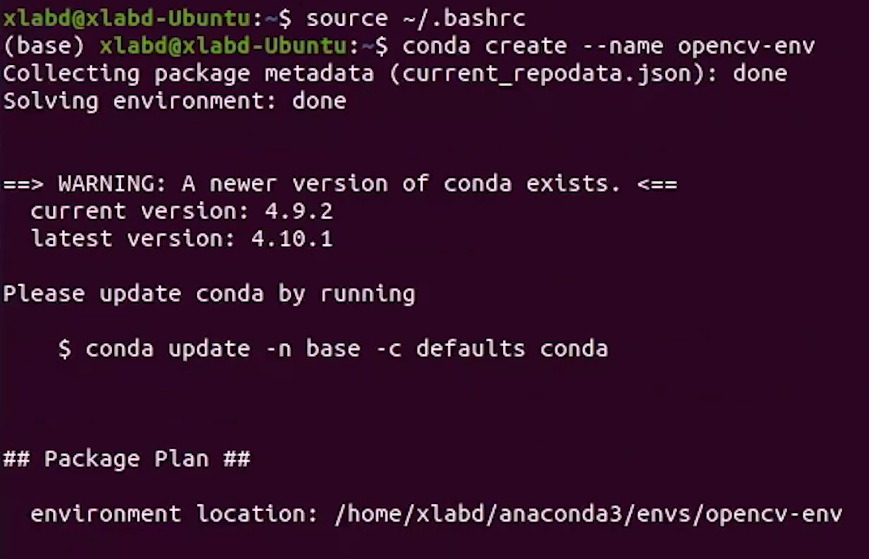

Software installation
1
2
Install Anaconda Navigator(latest version).
Open bash(ctrl + shift + p).
Follow the commands for successful installation.
bash ~/Downloads/filename.sh
Press Enter and accept all the license in installation.
Specify the PATH to installation.
source ~/.baserc
Conda create –name opencv-env
Conda activate opencv-env
Conda install –c conda-forge opencv
3
4
5

Slide 9
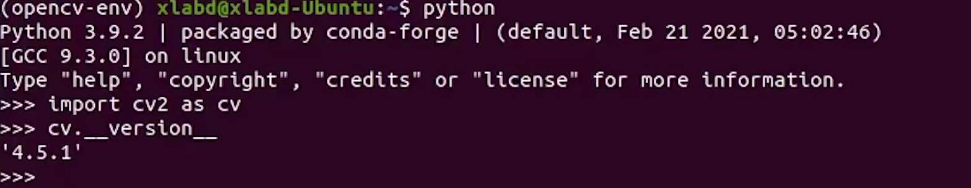
VERIFY Installation
Type python in the bash.
import cv2 as cv
cv.__version__

Slide 10
Summary
Successfully demonstrated how to set up a Computer Vision environment on Windows and Linux.
Used Anaconda Navigator to manage installations and virtual environments.
Installed OpenCV via the “conda-forge” channel.
Ensured proper verification of the setup using simple Python commands.
Highlighted system requirements and optional GPU acceleration.
Emphasized the importance of a structured, reproducible setup for computer vision projects.

Slide 11
THANK you

